Slide 1
Cryptocurrency Analysis
Gavin Fisher, Eric Hedgren, Blake Nelson
12/13/24

Slide 2
Background
What is the background of your task?
Predicting cryptocurrency prices involves analyzing tons of data on market trends, historical data, and external factors.
What kind of data you have?
The dataset is daily data points of all the major cryptocurrencies since they were created.
We shortened the scope to 2015 to eliminate the many years of low worth.
What problem you want to solve?
We want to see if we could find a way to better predict crypto prices

Slide 3
Datasets
What is the dataset?
Yahoo Finance provides crypto data since the beginning of crypto via its API
What features do you use?
Price of the cryptocurrency by date
What is the expected output by your machine learning models.
An estimation for the next day’s price

Slide 4
Related work
Previous methods
Time-series
analyze prices over time
Blockchain
add blockchain data
Time based weights
prioritize recent transactions
Notes:
Time-Series - transactions over time
Blockchain - The actual linking of transactions
time based weights - recent transactions have higher weights

Slide 5
Methods
Advantages
Linear Regression, Decision Tree, and KNN: Simple, intuitive, and interpretable models that can identify straightforward relationships between historical prices and future prices.
Random Forest, SVR, and Neural Network: Complex models that can capture non-linear relationships, handle large datasets, and provide robust predictions.
Disadvantages
Linear Regression and Decision Tree: Prone to overfitting, sensitive to outliers and noise, and may not capture complex patterns.
Random Forest, SVR, and Neural Network: Computationally expensive, require careful tuning of hyperparameters, and can be difficult to interpret.

Slide 6
Experimental setups
What features to use?
Price of the crypto currency
How about the training process?
100 epochs for the neural network
Learning rate is 0.001
Computed on CPU

Slide 7
Experimental results
Talk about the findings or insights from the results
From comparing out models we found out that Linear Regression and Neural Network were the best
Buy Bitcoin now
Do the results meet your expectations?
The linear regression model and neural network performed better than expected, but the others did not.

Slide 8
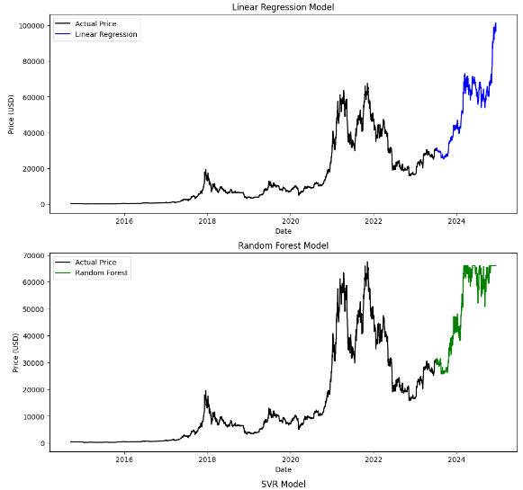
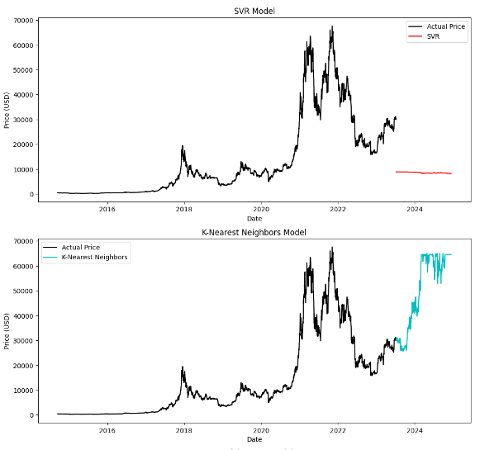
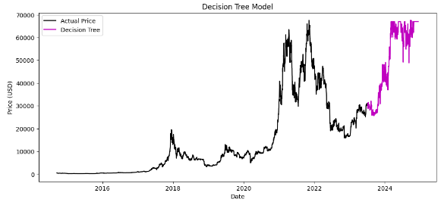
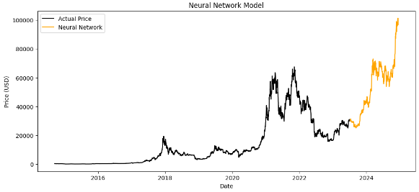

Slide 9
Conclusion and Future Work
Results
worked well for first model
comparable to other models
easy to interpret/understand
Improvements
incorporate crypto news
incorporate new advancements
handle sporadic changes

Slide 10
References
Chen, James, et al. "Temporal-Attention Augmented Bilinear Network for Financial Time-Series Forecasting." Journal of Machine Learning Research, vol. 21, no. 4, 2020, pp. 1-45.
Jang, Huisu, and Jaewook Lee. "An Empirical Study on Modeling and Prediction of Bitcoin Prices with Bayesian Neural Networks Based on Blockchain Information." IEEE Access, vol. 6, 2018, pp. 5427-5437.
McNally, Sean, et al. "Predicting the Price of Bitcoin Using Machine Learning." Journal of Risk and Financial Management, vol. 11, no. 2, 2018, pp. 61-82.
Shah, Devavrat, and Kang Zhang. "Bayesian Regression and Bitcoin." Annual Conference on Communication, Control, and Computing, vol. 52, 2019, pp. 409-414.
Yahoo Finance. “Yahoo Finance - Business Finance, Stock Market, Quotes, News.” Yahoo Finance, 2024, finance.yahoo.com/.

